Slide 1
The 8086 Microprocessors
Their Memory and Input/Output Interfaces

Slide 2
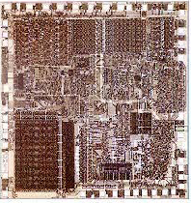
8086 and 8088 Microprocessors

Slide 3
• 8086 is a 16 bit microprocessor with a 16 bit data bus (1978)
• 8088 is a 16 bit microprocessor with an 8 bit data bus (1979)
• Both contain about 29,000 transistors, packaged in 40 pin dual-in-line package (DIP)
• Address lines A0-A7 and Data lines D0-D7 are multiplexed in 8088 as AD0-AD7.
– By multiplexed we mean that the same physical pin carries an address bit at one time and the data bit another time
• Address lines A0-A15 and Data lines D0-D15 are multiplexed in 8086 as AD0-AD15.

Slide 4
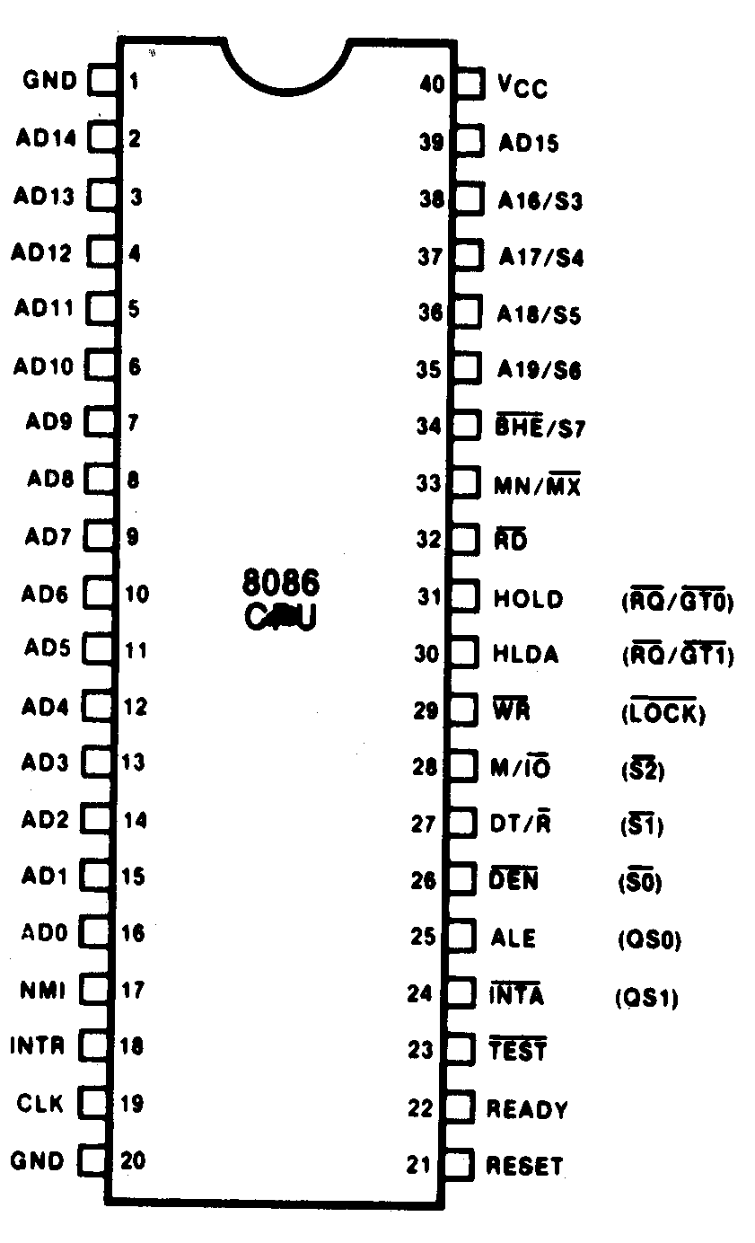
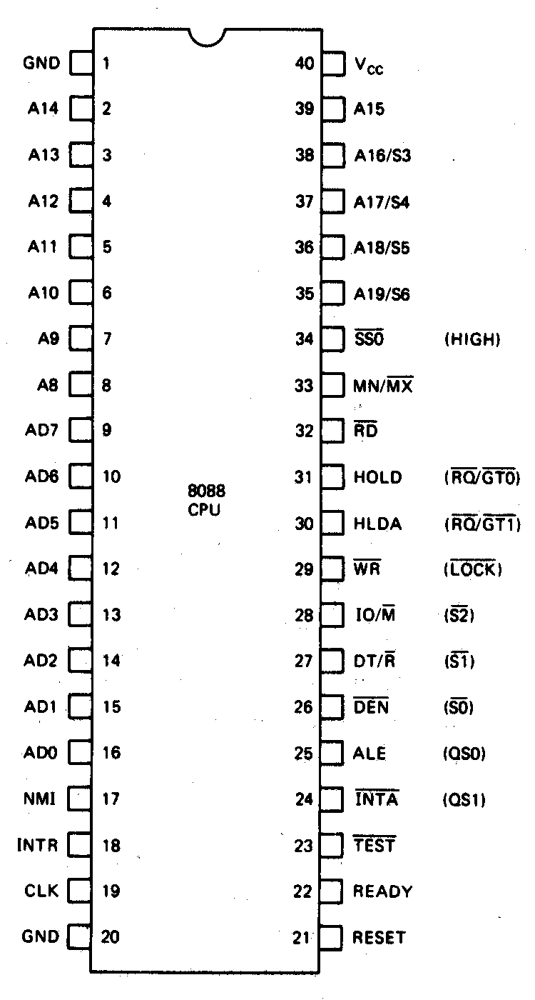

Slide 5
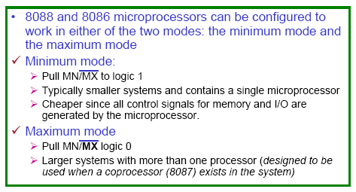
Minimum-mode and Maximum-mode Systems

Slide 6
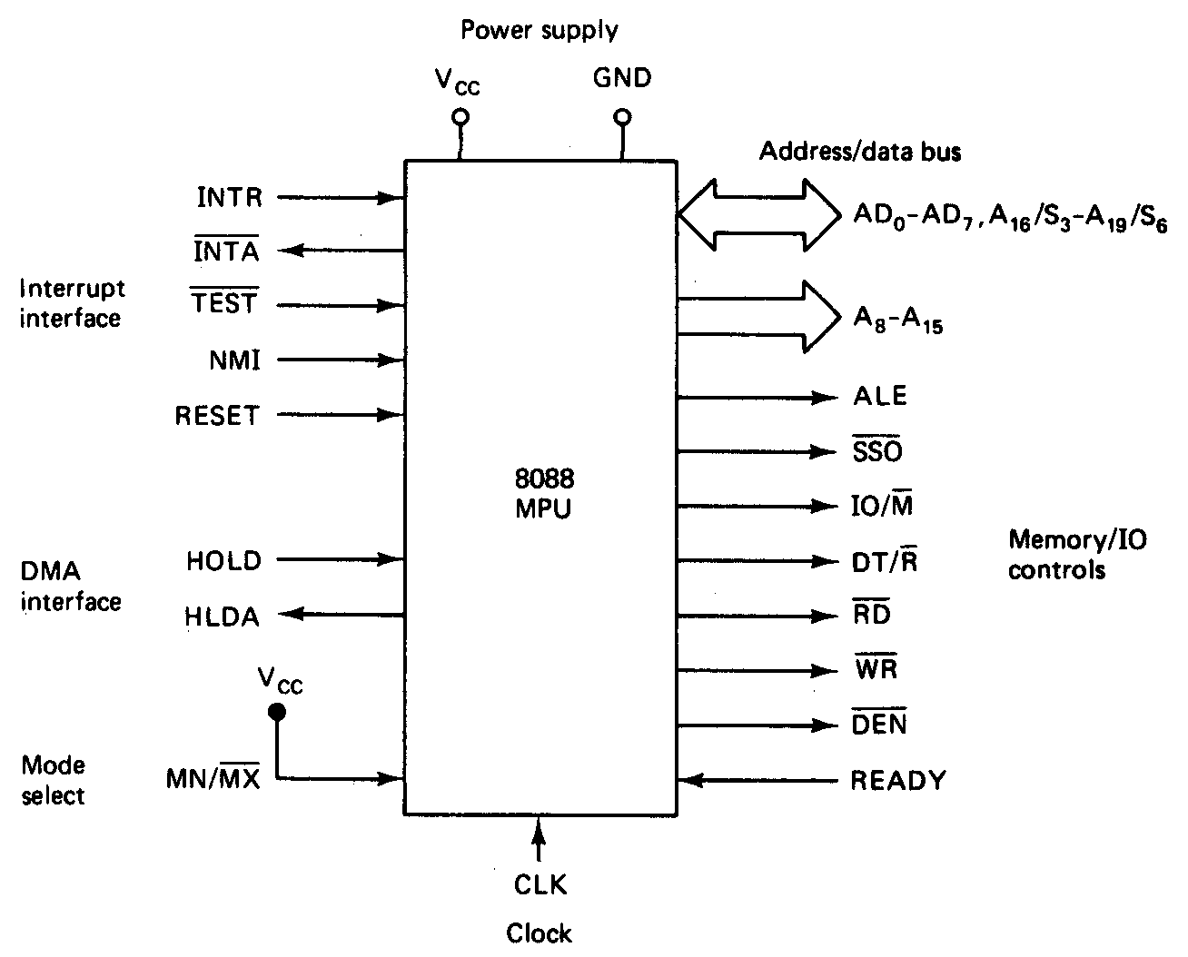
8088 Minimum-Mode Signals

Slide 7
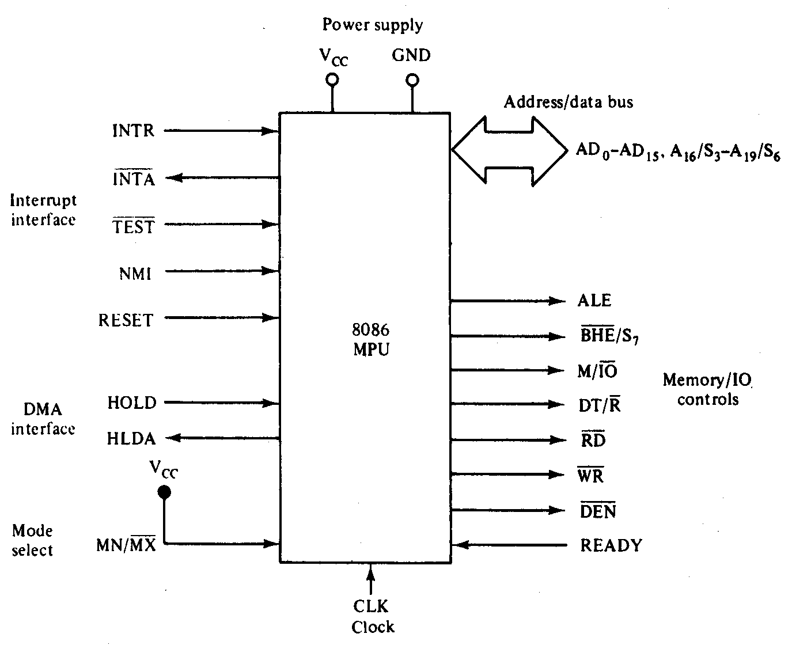
8086 Minimum-Mode Signals

Slide 8
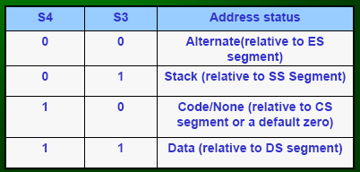
Minimum Mode Interface – Status Signals
• Status signals: A16-A19 multiplexed with status signals S3-S6 respectively
S3 and S4: a 2 bit binary code that identifies which of the internal segment registers was used to generate the physical address that was output on the address bus during the current bus cycle.
S5 is the logic level of the internal interrupt enable flag
S6 is always logic 0.

Slide 9
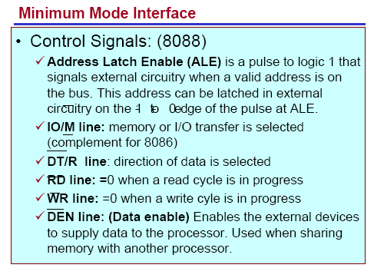


Slide 10
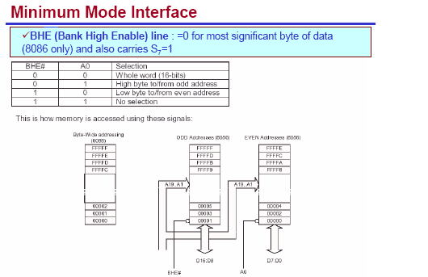

Slide 11
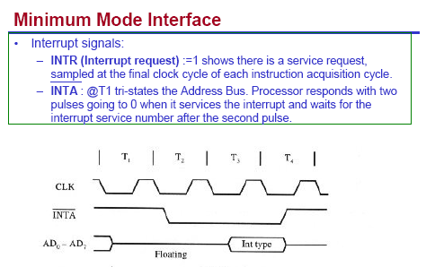

Slide 12
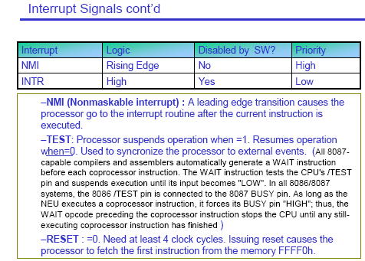

Slide 13
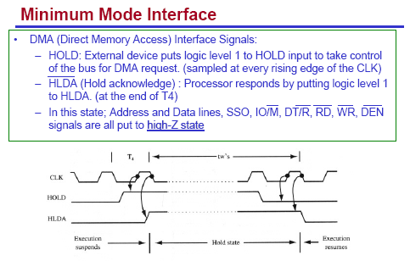

Slide 14
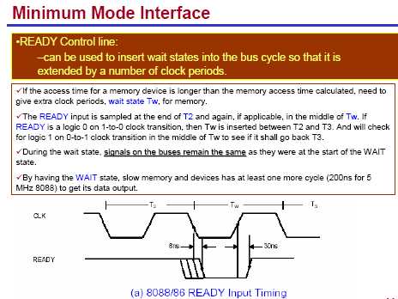

Slide 15
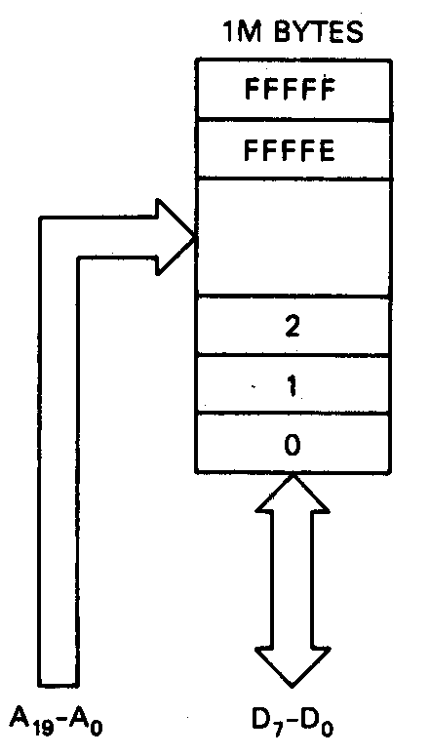
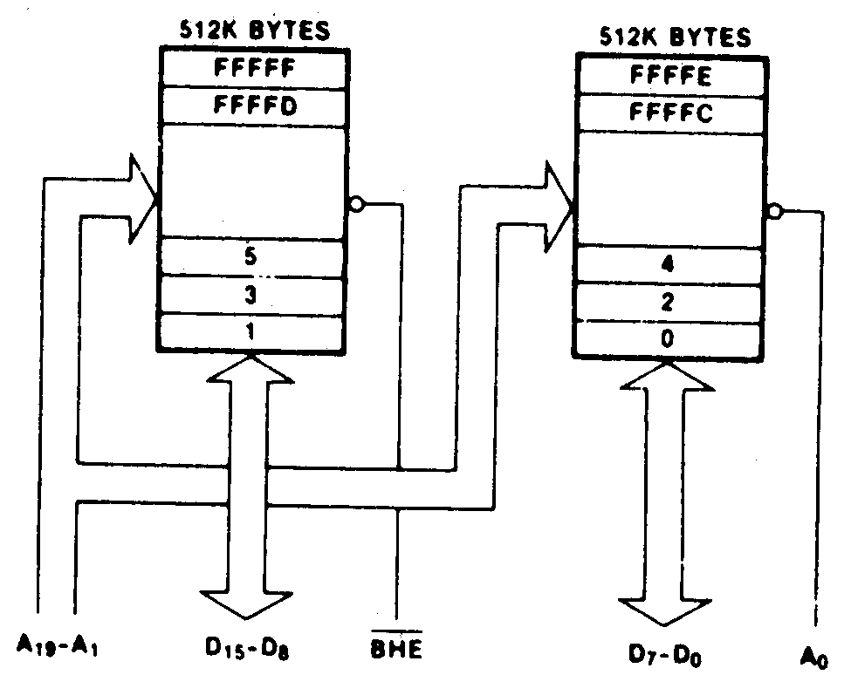
Hardware Organization of the memory Address Space
8088
8086

Slide 16
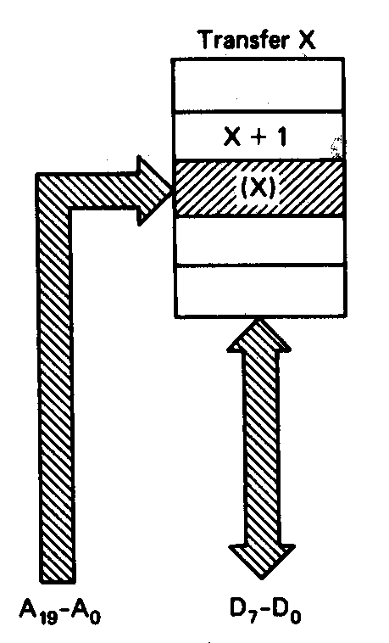
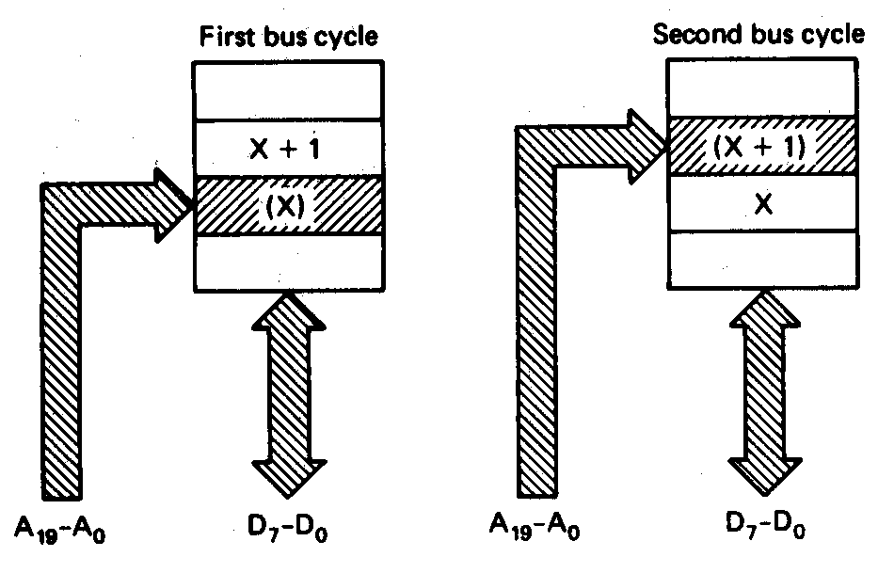
8088 byte transfer
8088 word transfer

Slide 17
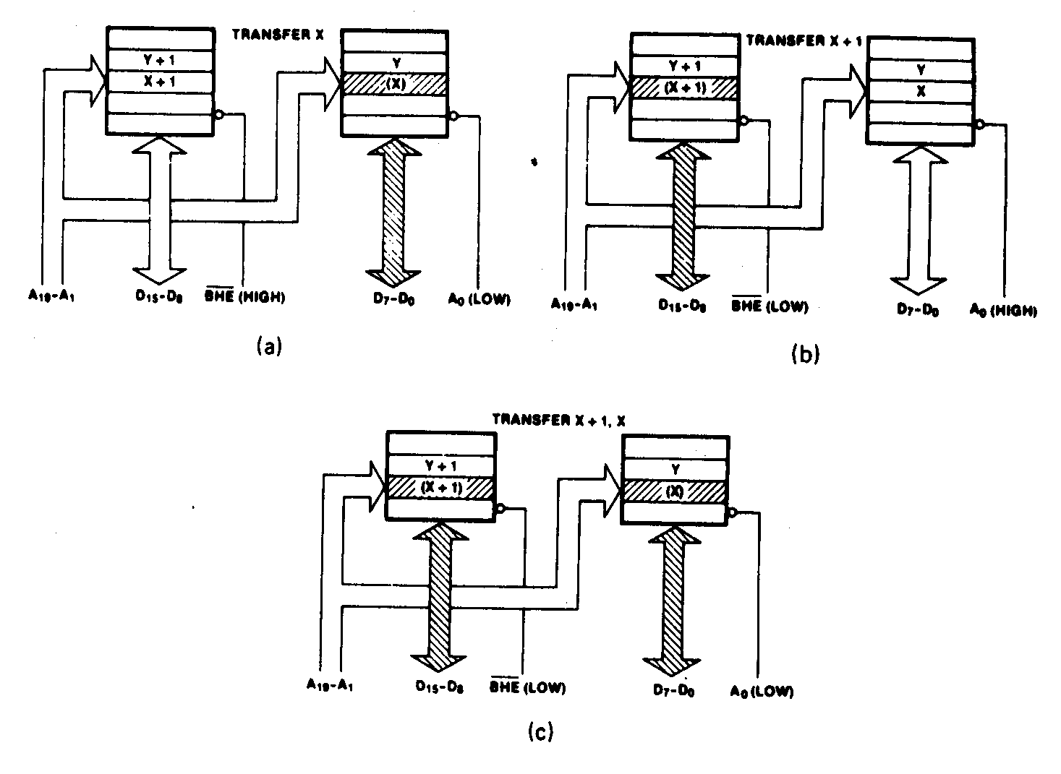
Even-address byte transfer
Odd address byte transfer
8086
Even-address word transfer

Slide 18
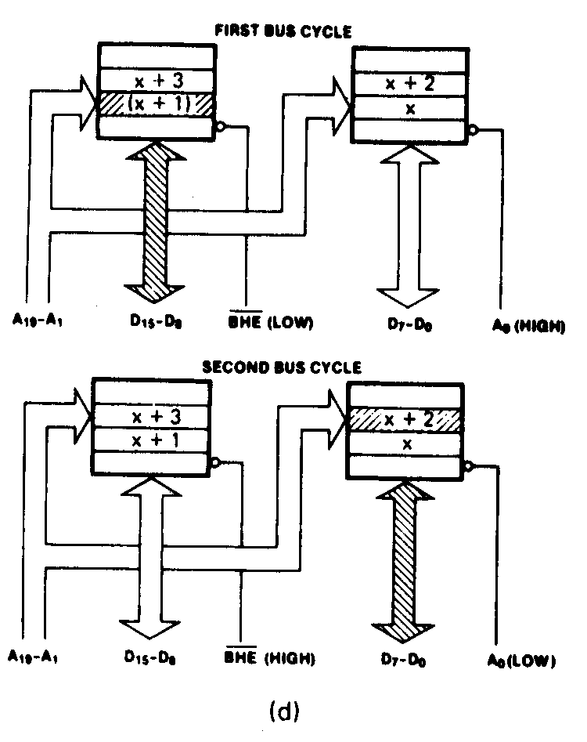
8086
Odd-address word transfer

Slide 19
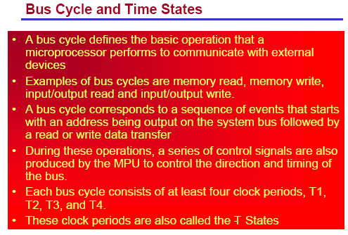

Slide 20
Bus Cycle and Time States
T1 - start of bus cycle. Actions include setting control signals to give the required values for ALE, DTR, IO/M putting a valid address onto the address bus.
T2 - the RD or WR control signals are issued, DEN is asserted and in the case of a write, data is put onto the data bus. The DEN turns on the data bus buffers to connect the CPU to the external data bus. The READY input to the CPU is sampled at the end of T2 and if READY is low, a wait state TW (one or more) is inserted before T3 begins.
T3 - this clock period is provided to allow memory to access the data. If
the bus cycle is a read cycle, the data bus is sampled at the end of T3.
T4 - all bus signals are deactivated in preparation for the next
clock cycle. The 8088 also finishes sampling the data (in a read
cycle) in this period. For the write cycle, the trailing edge of the
WR signal transfers data to the memory or I/O, which activates
and write when WR returns to logic 1 level.

Slide 21
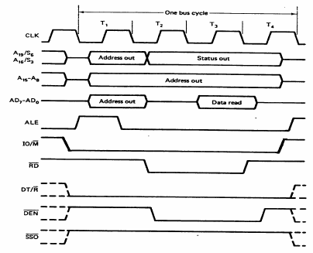
Memory Read Cycle of the 8088

Slide 22
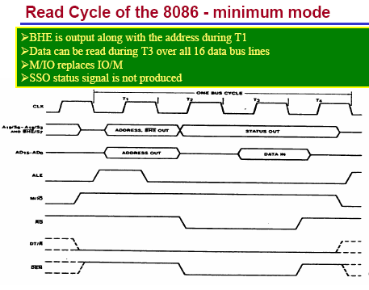

Slide 23
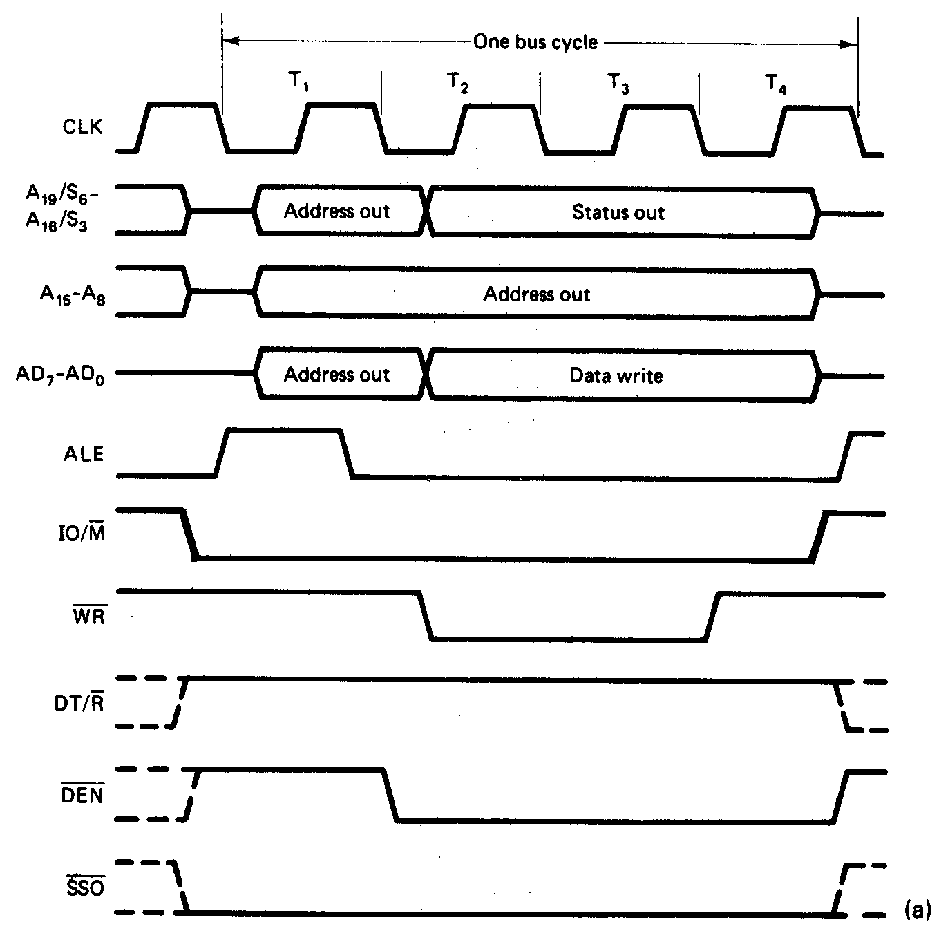
Write Bus Cycle 8088 M-M

Slide 24
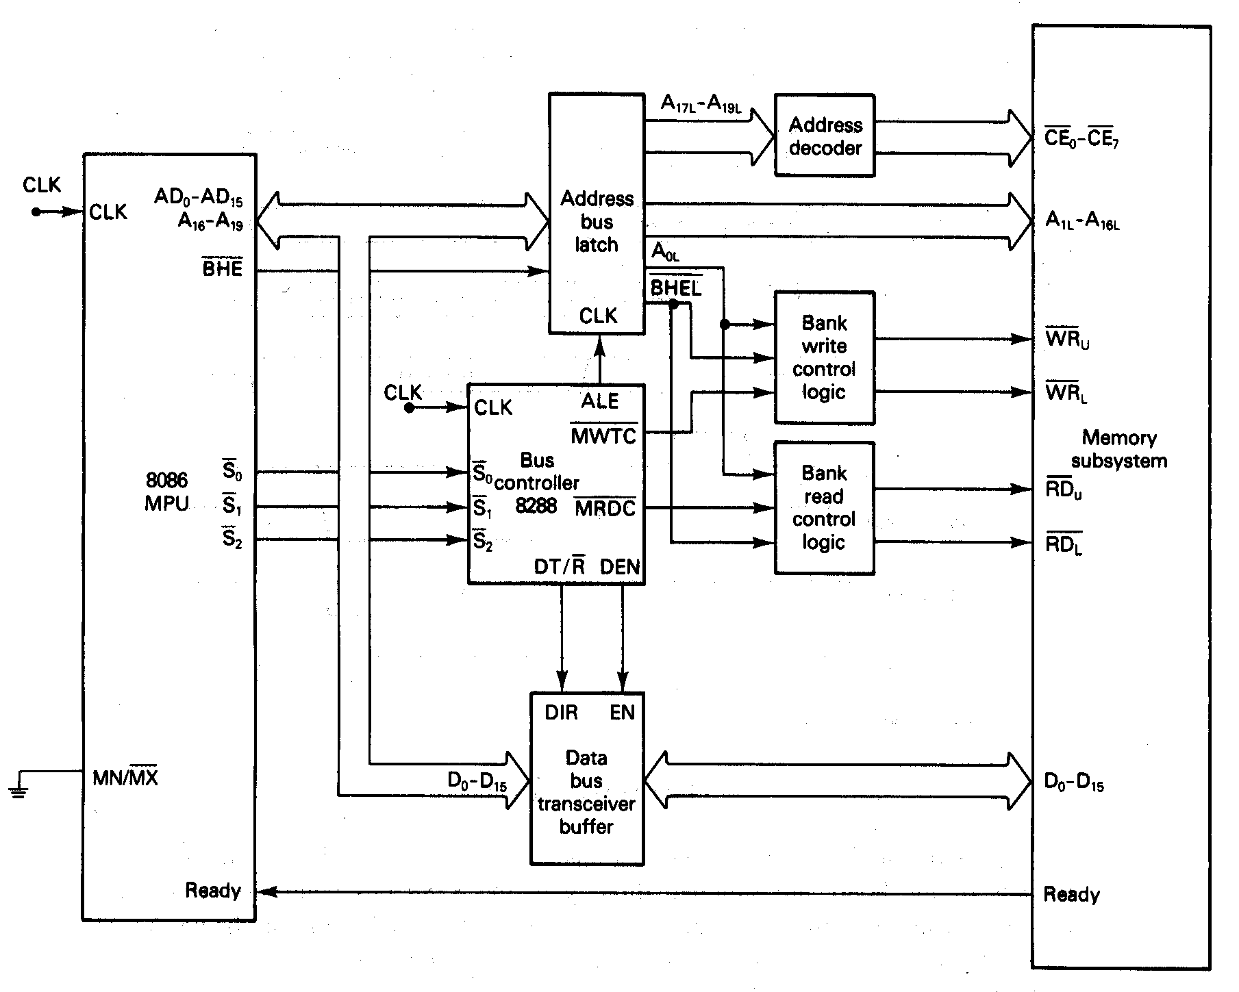
Memory Interface Circuits

Slide 25
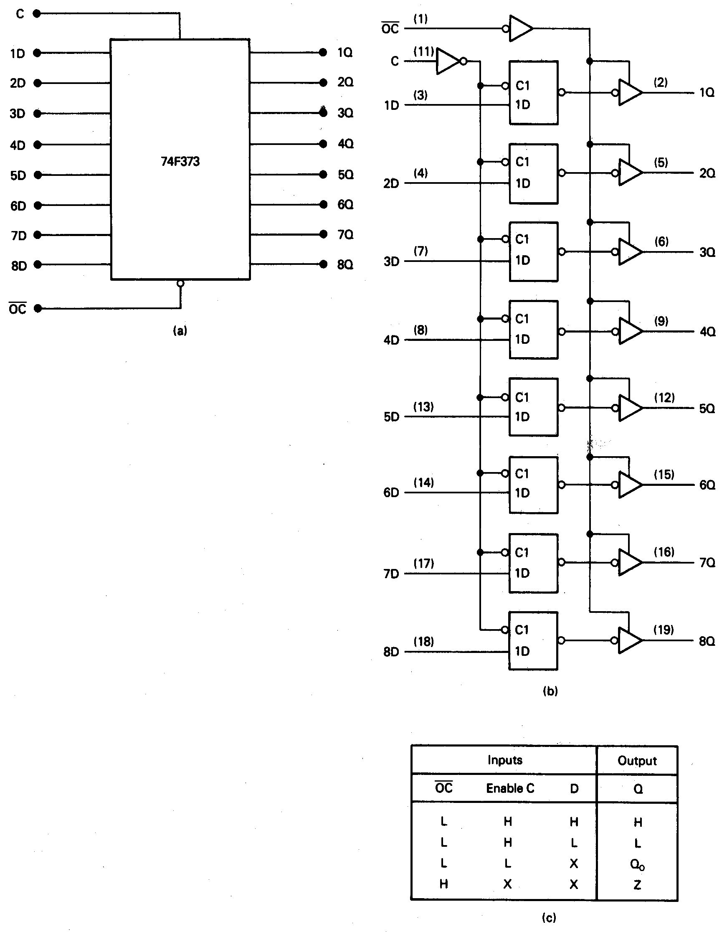
Address Bus Latches and Buffers

Slide 26
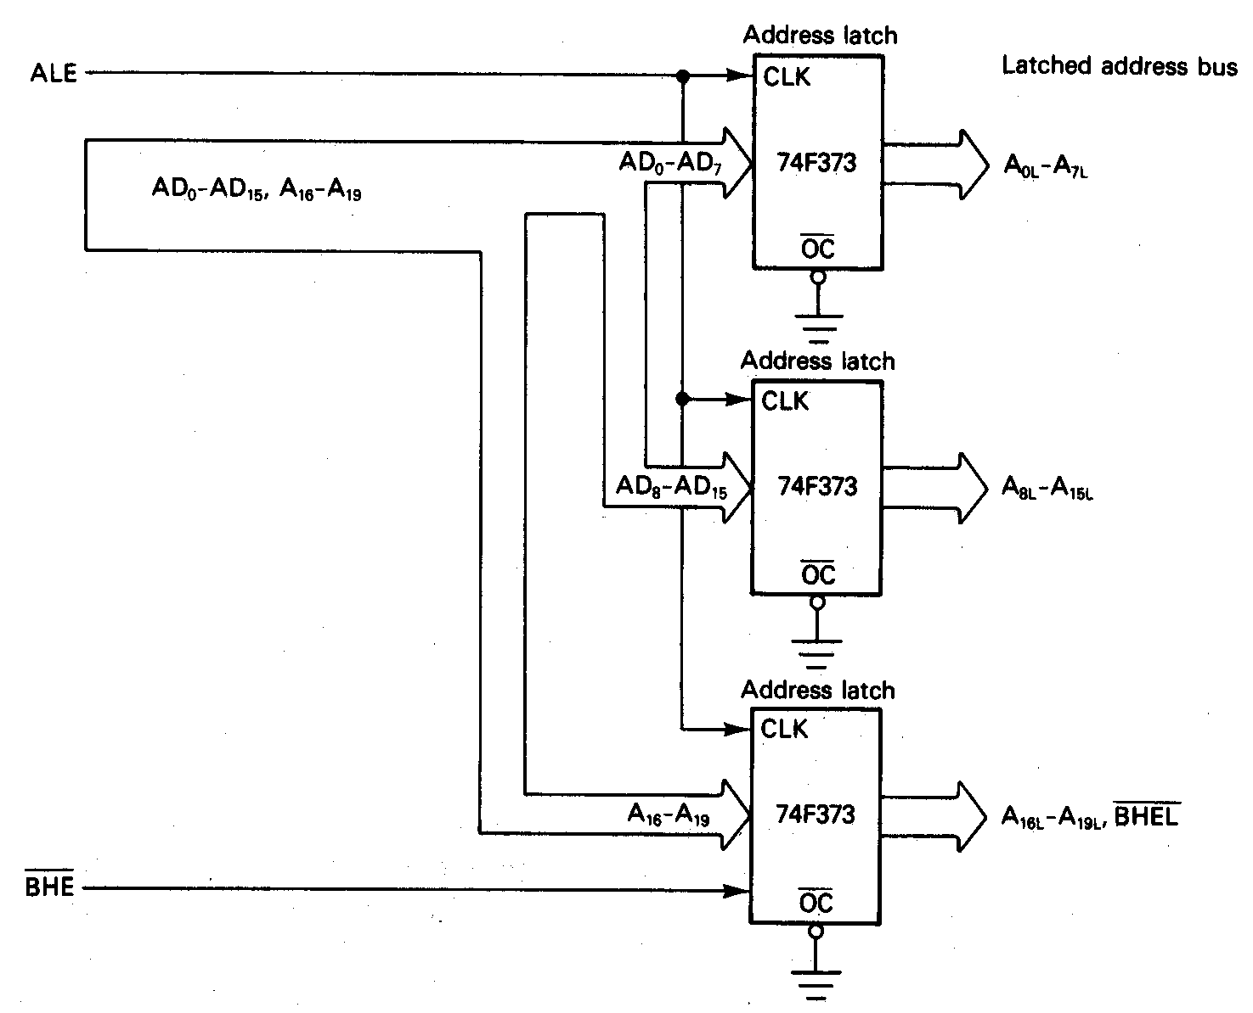
Address Latch Circuit

Slide 27
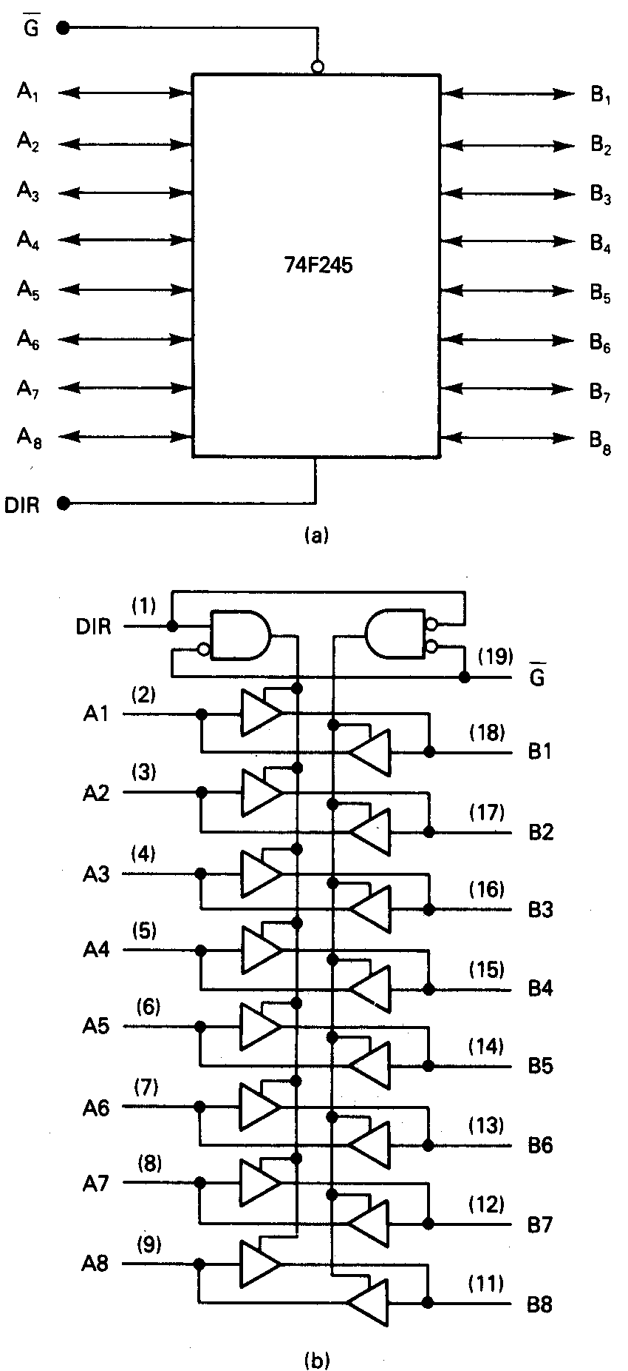
Data Bus Transceivers

Slide 28
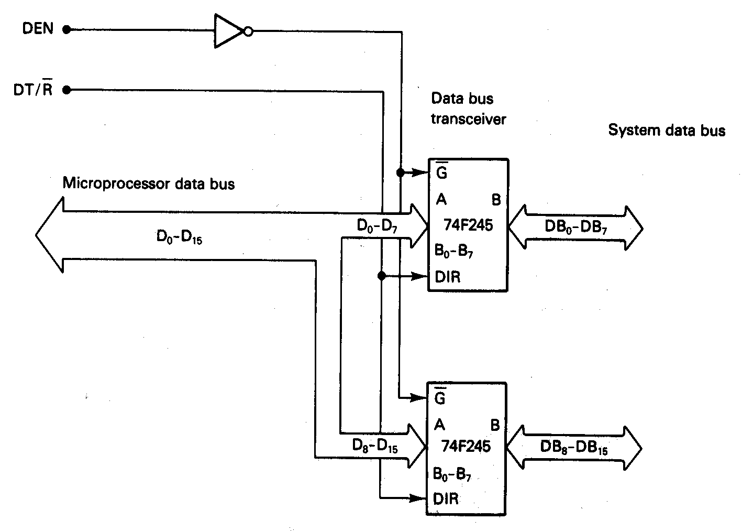
Data bus Transceiver Circuit

Slide 29
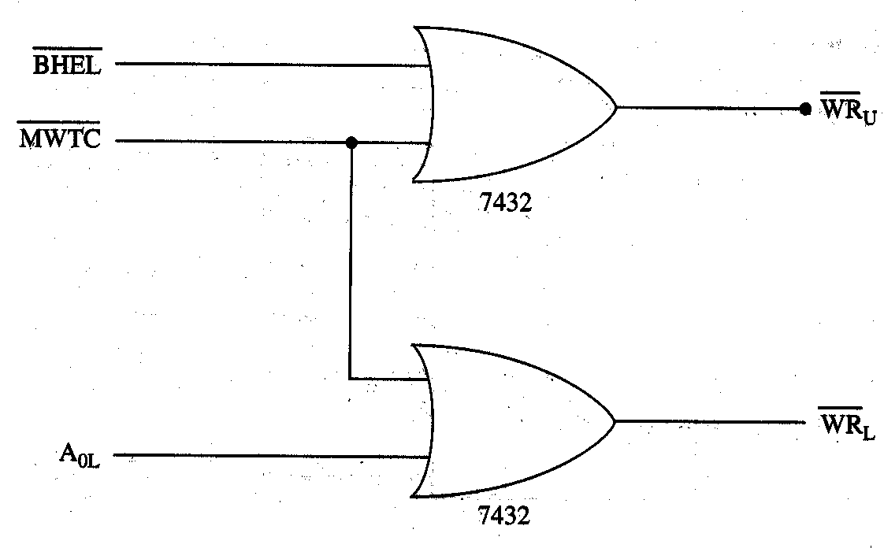
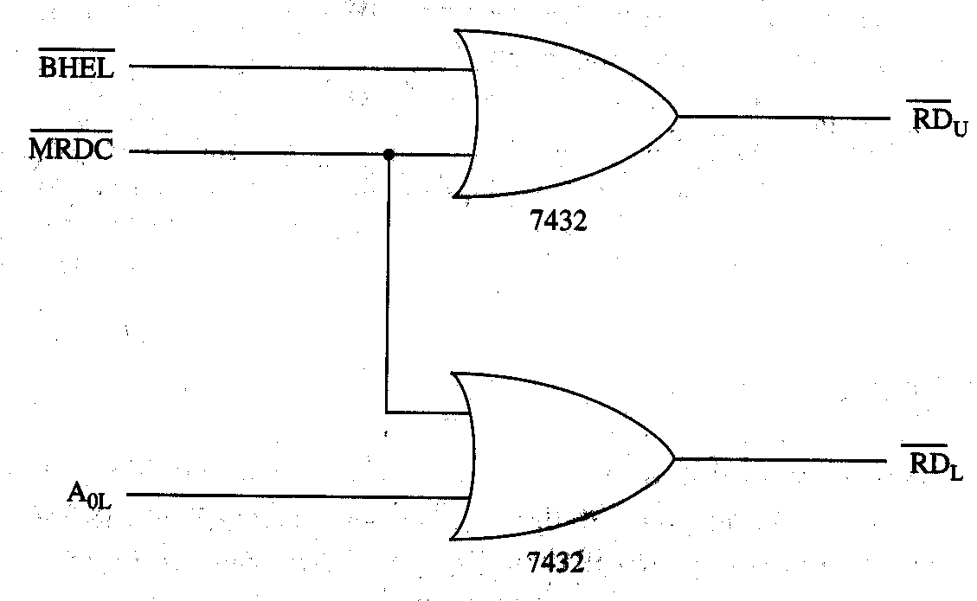
Bank Write and Bank Read Control Logic
Bank Write Control Logic
Bank Read Control Logic

Slide 30
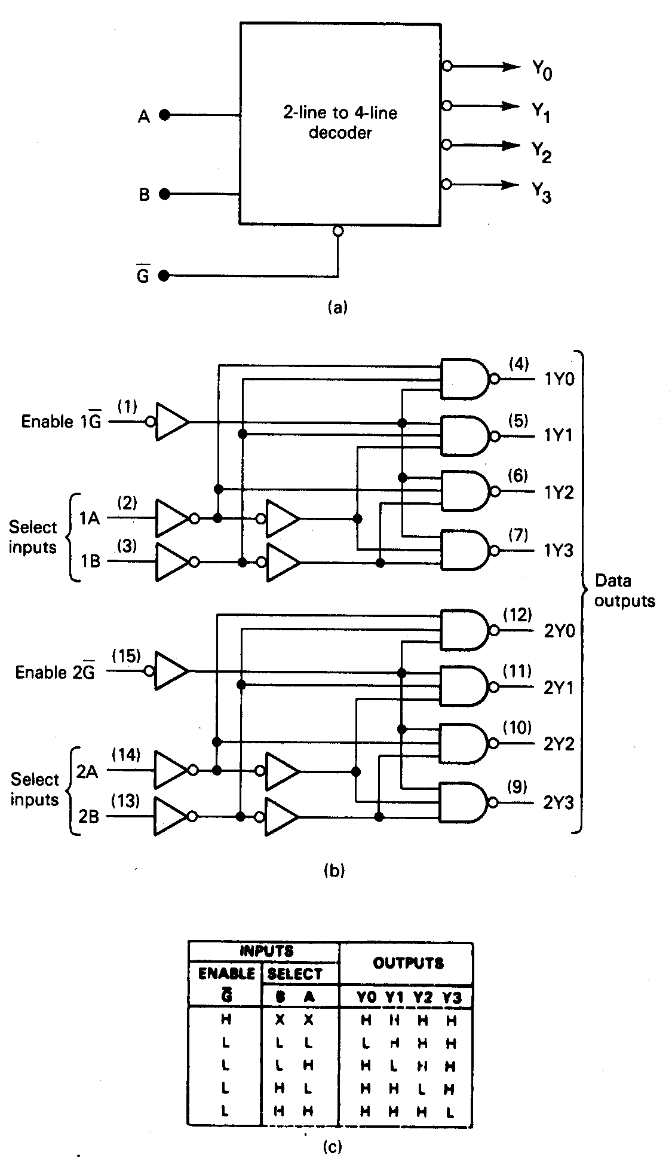
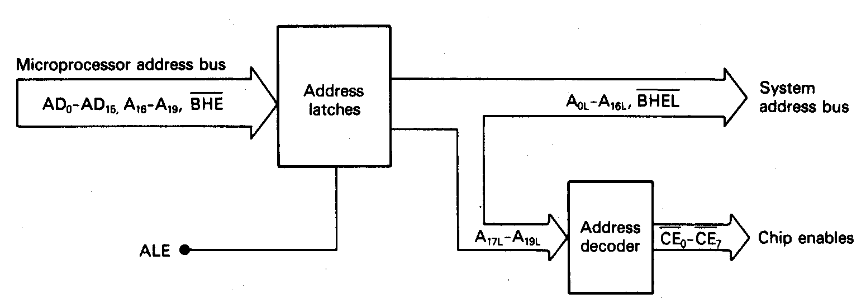
Address Decoders

